Slide 1
A. T. Still University School of Osteopathic Medicine Arizona
Ohio

Slide 2
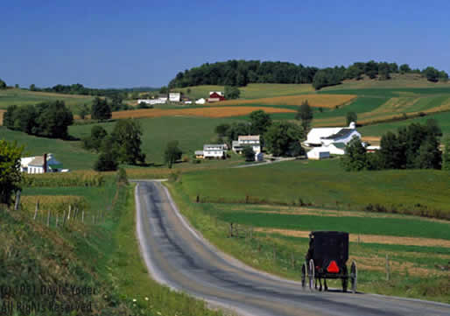
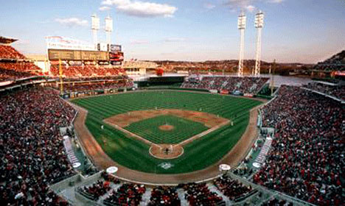
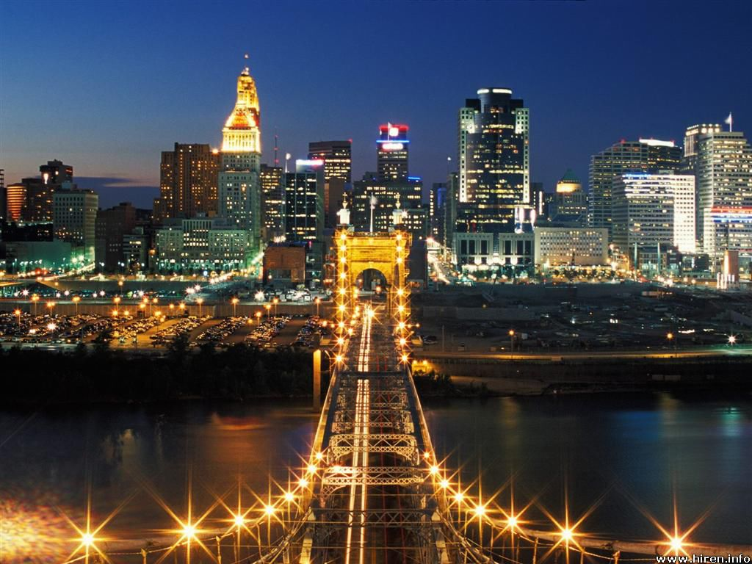
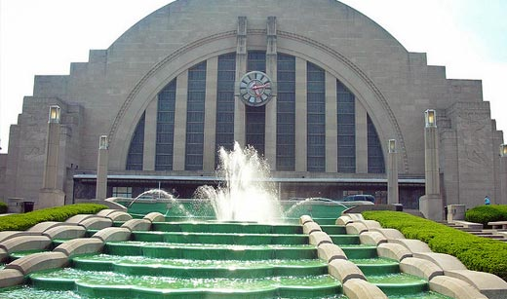
Forbes magazine declared Cincinnati the fifth most affordable metropolitan areas to live in the United States.
Why Ohio…
Forbes magazine ranked Cincinnati ninth overall for safest cities.
Lonely Planet named Cincinnati their #3 U.S. travel destination for 2012.
AOL Real Estate ranked Cincinnati in its top 10 for young people, recognizing Cincinnati's dirt-cheap rents and cost of living.

Slide 3
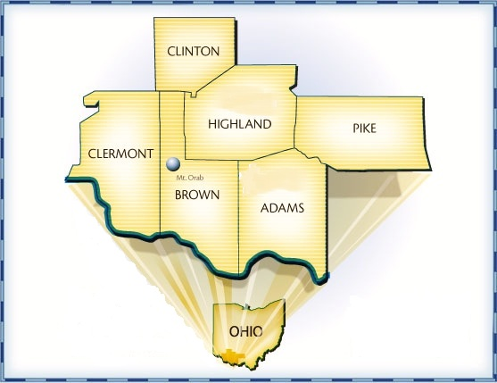
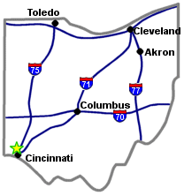
Based in Mount Orab, OH
Variety of cultures and people: Amish to Appalachian
Affiliations with world class Cincinnati Children's and OUCOM
45 minutes from Cincinnati
Variety of rotations from inner
city to underserved rural communities
30 minutes to Amish County (Adams)

Slide 4
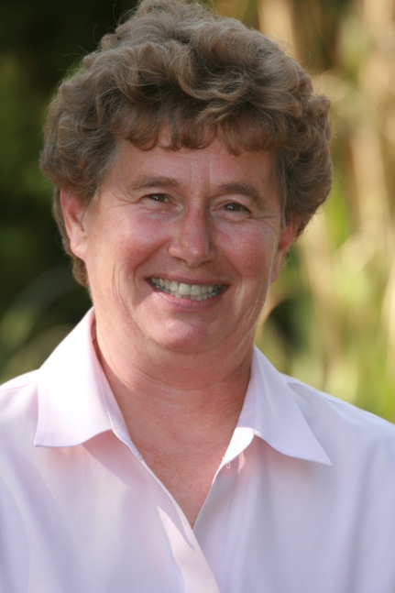
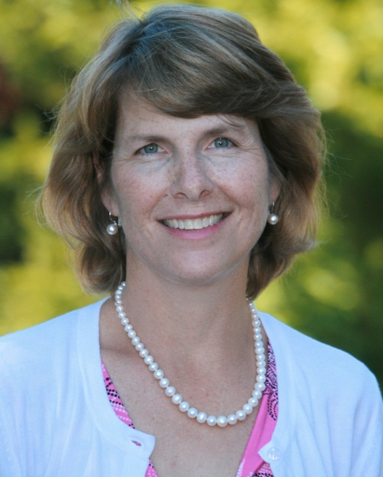
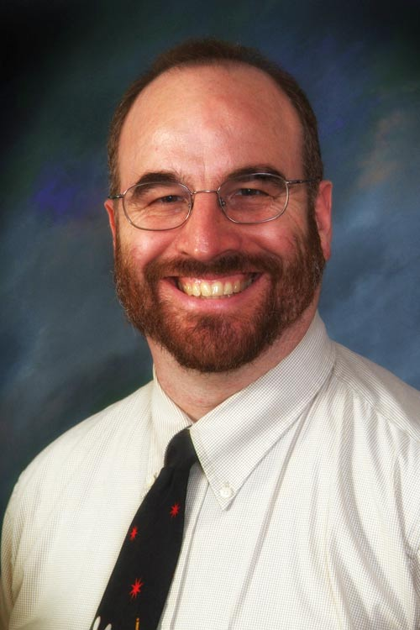
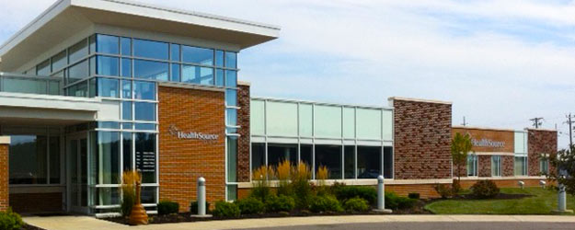
Healthsource of Ohio
A not-for-profit primary care organization consisting of medical, dental, and mental health services.
Who are we?
RDMEs
E. Ann Pedigo M.D.
Catherine A. Shanahan M.D.
Richard Broder-Oldach D.O.

Slide 5
“I think the biggest "pro's" are Dr. Pedigo and Dr. Shanahan. They are well-connected, knowledgeable, compassionate, sincere, and patient. I can't think of any better advocates for the students and their families.”
Dr. Russell Roberts, 2012 IM
“Dr. Pedigo and Dr. Shanahan are invaluable to your medical career from start to finish. Even after graduating they have been there for me. They go above and beyond and you can’t put a price on that.”
Dr. Adam Levin, 2012 ER
“Pros: Dr. Pedigo & Dr. Shanahan. Need I say more? Really, you will never have a better advocate for your education. They care a lot about you and they show it.”
Dr. Jeffery Neitzel,
2011 Surgery
“…once you decide on a specialty, there are so many opportunities to be truly mentored by an awesome doctor… The area is extremely affordable, even for a family living on one income or just on loans. Mt. Orab is small, but Cincinnati is close by, as is Columbus, Louisville, Indy, etc.”
Dr. Paul Round, 2011 Peds
Testimonies
from Alumni
"I am confident that I can go anywhere and be successful with the training I received from health source."
Dr. Lenora Evans-Hollmann, 2012 FP

Slide 6
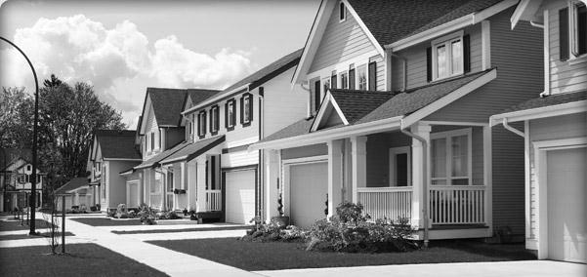
Housing
Mariemont/Oakley area
30mi to school
Places students live
Cost of living – affordable!
Mar. 2012 cost of living index in Cincinnati: 89.6
Mar. 2012 cost of living index in East Cincinnati: 83.6
Mar. 2012 cost of living index in Eastgate: 84.7
http://www.city-data.com
Gas prices lower than national avg. $3.78 – Sept 26, 2012
Downtown
40mi to school
Eastgate Area
20mi to school
20mi to downtown
School house

Slide 7
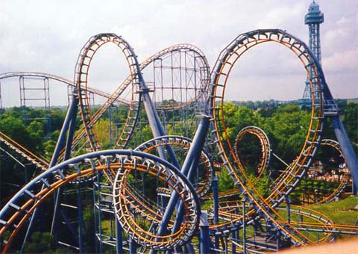
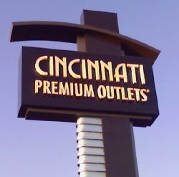
Life in Ohio
Kings Island Theme Park
Flying Pig Marathon
Oktoberfest
Cincinnati Zoo
Cincinnati Aquarium
Historic Underground Railroad
More ideas at
http://cincinnatiusa.com/
http://consumer.discoverohio.com/#
http://ohio.gov/tourism/
Natural Preserves
Wine Festivals
Outlet Malls
Hiking
Kayaking and Water Sports
Miles of Bicycle Trails
Red River Gorge, KY

Slide 8
Sports

Slide 9
“…for a city girl, Ohio was definitely a shock. Country life was a little outside of my comfort zone but after 3 years I look back with fond memories! If you aren’t use to country life you will feel out of your element…”
Ashley, Spouse
“…I don't know if other CHC sites also involve a lot of travel, but I would say that's definitely a con…”
Lindsey, Spouse
“Not as many opportunities to work in academic style hospitals or around residents… (working with residents is totally different than working with attending's).”
Dr. Jeffrey Neitzel, 2011 Surgery
Testimonies
For Better or For Worse
“Being out in rural Ohio facilitated a bond that in my opinion was stronger than any other program anywhere. We still visit, travel and talk daily to fellow students and spouses…”
Dr. Stefanie Moore, Peds
“It is indeed a very small area, which people need to realize before they go. Basically, the only thing nearby in Mt. Orab is the local grocery store, a little library, and an ice cream shop…”
Andrea, Spouse

Slide 10
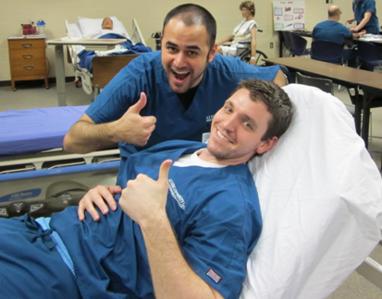
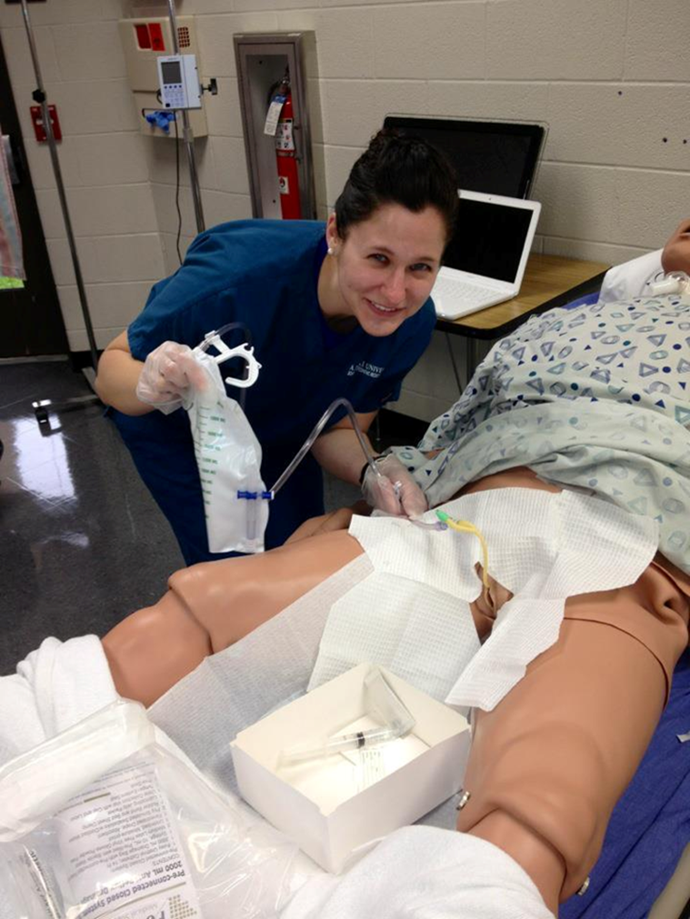
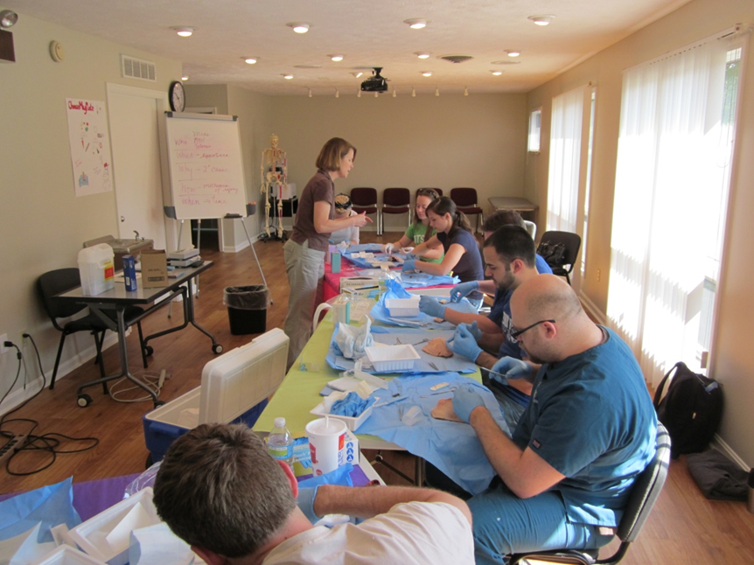
Simulation Lab at Southern State Community College Nursing School
Airway management
IV access and injections
Arterial Blood Gas
Sterile gown & procedure
Wound Care
Foley catheter
What are we doing?

Slide 11
Education
Mon. | Tues. | Wed. | Thurs. | Fri.
Free Morning! | Small Group | Clinic or Day off! |  | Small Group
Exam day or Epi/Bio or Day off! | OPP |  |  | Monthly Grand Rounds with 3rd & 4th years
Access to OSCEs to prepare for Step 2
Interview and Personal Statement Writing workshops
Interactions with students from OU
Dedicated ACLS course for our students only
Dedicated Osteopathic Hospitals in the area
Osteopathic Society activities
Dinners and opportunities to interact with DO’s from all specialties in the community.
Health Source of Ohio
http://www.healthsourceofohio.com/
Mercy Hospitals
http://www.e-mercy.com/
Jewish Hospital
http://jewishhospitalcincinnati.com/

Slide 12
What is next? Looking at Residency
100 Osteopathic Residencies in Ohio!!
Wont you be my neighbor?
3 Osteopathic Residencies in Indiana
7 Osteopathic Residencies in Kentucky
17 Osteopathic Residencies in West Virginia
102 Osteopathic Residencies in Pennsylvania
196 Osteopathic Residencies in Michigan
http://www.opportunities.osteopathic.org/search/search.cfm

Slide 13
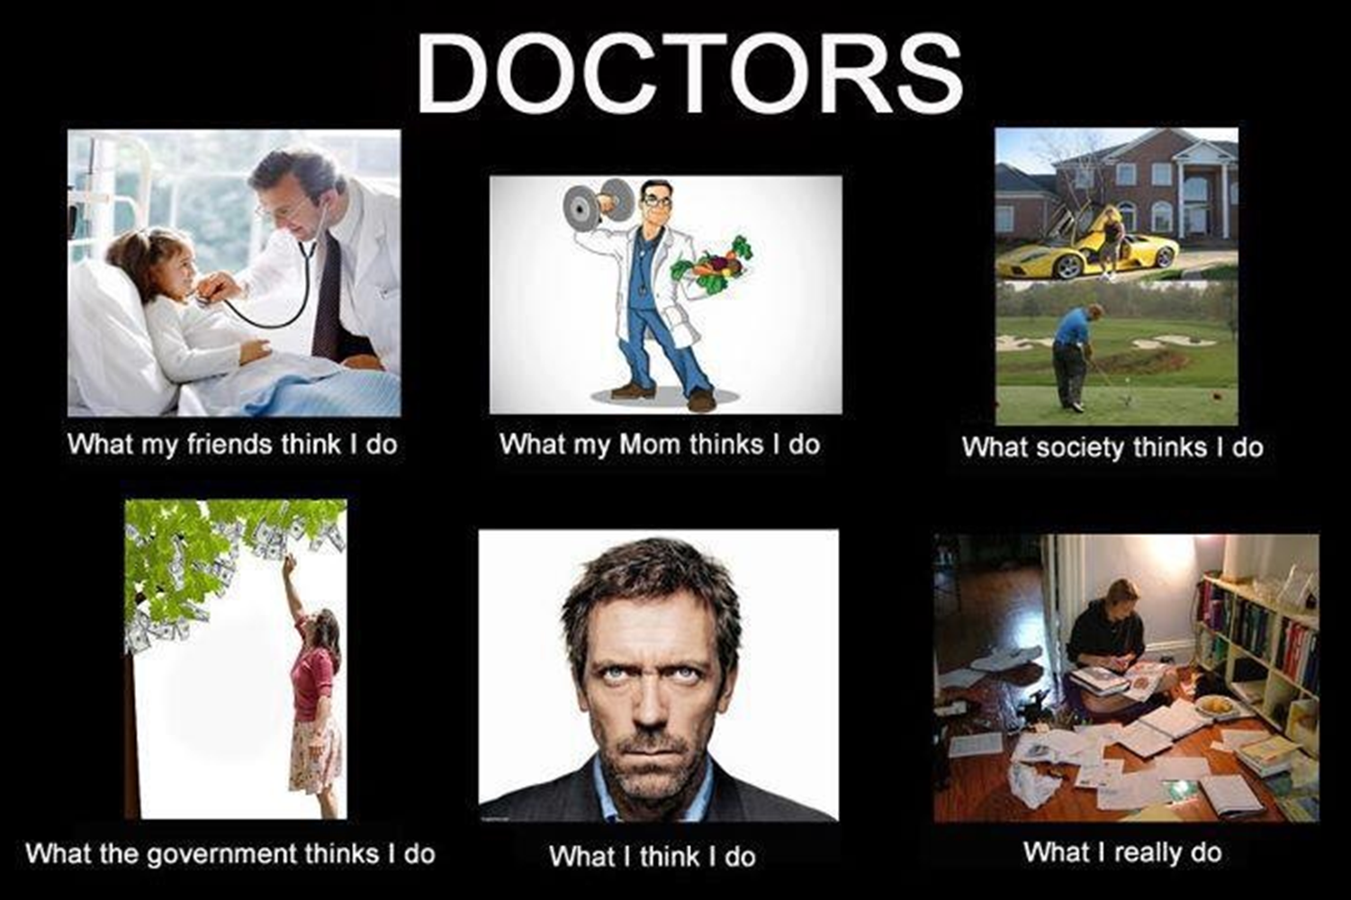
What have we already accomplished?
MATCHED INSTITUTION | RESIDENCY PROGRAM
Providence Sacred Heart Med Ctr. | Internal Medicine
University Hospital | OG/GYN
MSUCOM/St. Joseph Mercy | Emergency Med
Memorial Hospital | General Surgery
Univ of Texas/Southwestern Med | Pediatrics
MWU-AZCOM-Cottonwood | Internal Medicine
Valley Baptist Medical Center | Family Medicine
OUCOM/Grandview Hospital | Family Medicine
Grant Medical Center | Family Medicine
Trover Foundation | Family Medicine
University of Missouri | Emergency Medicine
Kent Hospital | Emergency Medicine
University of Wisconsin | Psychiatry
Plaza Medical Center | Internal Medicine
Women & Childrens Hospital | Pediatrics

