Slide 1
Anchoring University Competencies to Programmatic Accreditation
Katherine Adler, DHA, FACHE
Jane Hawthorne, BS
AT Still University of Health Sciences
Notes:
Kathy starts followed by “howdy” from Jane

Slide 2
Who Are You?!
Graduate institution?
Undergraduate institution?
Size?
Single program?
Multiple programs?
Online, residential, blended?
Notes:
Jane to ask questions
End with “did we miss anyone?”

Slide 3
Who is ATSU?
Founded in 1892 by Andrew Taylor Still, MD, recognized as the father of osteopathic medicine
Originally called American School of Osteopathy
Now six schools in two states (one virtual)
Kirksville College of Osteopathic Medicine (KCOM)
School of Health Management (SHM)/(CGHS)
School of Osteopathic Medicine in Arizona (SOMA)
Arizona School of Health Sciences (ASHS)
Arizona School of Dentistry & Oral Health (ASDOH)
Missouri School of Dentistry & Oral Health (MSDOH)
Notes:
First medical school to admit women as students
Jane hand off to Kathy after this slide

Slide 4
A Study in Similarities and Contrasts
General focus: Graduate Health Education
Fall 2013 enrollment: 3,314
Full time: 66%, Females: 55%, 9 countries
Student:Faculty = 13:1
21 programs, 9 certificates
Graduation rates: 48% - 99%
Faculty Model: Full, Part-time, and Adjunct

Slide 5
Kirksville, MO Campus
Notes:
Center of town in central US– 150 acres with city population of 17,500

Slide 6
Mesa, AZ Campus
Notes:
59 acres, urban setting with population of 439,000

Slide 7
What Our Students Study
Health Sciences
21 degree programs
12 Doctoral
9 Master’s
Residential programs: Athletic Training, Audiology, Biomedical Medical Sciences, Dentistry, Occupational Therapy, Osteopathic Medicine, Physical Therapy, Physician Assistant Studies
Online programs: Health Administration, Health Education, Health Sciences, Kinesiology, Public Health, post-professional degrees
Notes:
Kathy starts here
How do these disciplines even relate to one another?!
Online includes degrees to upgrade experienced professionals with basic degrees to either a Master’s or Doctorate
Examples of post professional degrees:
APA
TDPT

Slide 8
Osteopathic Tenets
The body is a unit; the person is a unit of body, mind, and spirit.
The body is capable of self-regulation, self-healing, and health maintenance.
Structure and function are reciprocally interrelated.
Rational treatment is based upon an understanding of the basic principles of body unity, self-regulation, and the interrelationship of structure and function.
Notes:
How do you tie in the following to the University’s foundation? Through the university mission

Slide 9
ATSU Mission
A.T. Still University of Health Sciences serves as a learning-centered university dedicated to preparing highly competent professionals through innovative academic programs with a commitment to continue its osteopathic heritage and focus on whole person healthcare, scholarship, community health, interprofessional education, diversity, and underserved populations.

Slide 10
Where to Start?
In 2009, the Board of Trustees established what attributes any graduate from ATSU must have.
Altruism
Accountability
Respect
Integrity
Ethic(ism)
Honesty
Compassion / Caring
Excellence
Lifelong learning
Self-regulation
Service
Notes:
This are the things we need to achieve, which drive the program competencies
Programmatic competencies are also driven by accreditation competencies
Course competencies flow to the programmatic competencies
So there’s the SNAIL TRAIL

Slide 11
8 Transferable Skills
Positive Interpersonal Communication
Cultural Competence
Interdisciplinary/Team Focus
Leadership
Self Assessment and Reflective Practice
Critical Thinking
Ethical and Legal Understanding
Wellbeing
Notes:
Eight transferrable skills
So anyone graduating from our university, from any of our programs, would be proficient in…..
So how do you know you are meeting your goal? You need a map…..

Slide 12
A Map to Where?
The 8 transferable skills were mapped to Program Competencies; first 2 reviewed:
Interpersonal Communication
Cultural Competence
Programmatic Competencies mapped to Program Accreditation Competencies
Use the language from the accreditation competencies for program AND course competencies.
Notes:
Transferrable skills become part of the total programmatic competencies and are mapped to individual course competencies (when the Board says do it, you do it)
What we found, however, is that the transferrable skills were mapping back to program accreditation competencies. We were so excited! This was working! We then started to take a look at individual course competencies and learned an important thing.
hint, make course competencies the SAME (or intersecting with) as programmatic competencies)(pearl of wisdom)

Slide 13
MPH Program
Totally asynchronous and online
Students and practicum sites are nationwide
Accrediting body for MPH Programs is CEPH
Council on Education for Public Health
5 Core Areas of Public Health Knowledge
Association of Schools of Public Health
Established and accepted competencies that encompass the 5 Core Areas
Notes:
So, as a school we decided to start with our Public Health Program – which incidentally is going through CEPH accreditation – so we needed to do this.

Slide 14
How Does It All Work?
Course
Curriculum
Accreditation
Program
University
DOCUMENTATION
Notes:
We figured this out by accident
Students are required to have a field experience in order to complete the MPH program.
CEPH requires that we demonstrate how the students master the core competencies during the practicum experience = DOCUMENTATION, DOCUMENTATION, DOCUMENTATION (prove it!)
Discuss mapping TS to accreditation competencies which were mapped to curriculum, which were mapped to course (MPH and APHS competencies to CEPH competencies)
High level analysis – don’t get bogged down in the details here
Process for field experience needs to be student centered and EASY for faculty to negotiate.

Slide 15
Field Experience and a Virtual Binder
At this point, paper is your friend! Collect any and every piece of paper related to your process.
If you don’t have a process, create one on paper.
What is the final product of the process?
Who will need to see the product?
Faculty
Program Chair
Dean
Accrediting Body
Notes:
You will be overwhelmed
We will underwhelm the process
Linking competencies to field experience binders
Establish what your field experience is going to consist of and the process for documentation (some may have paper process already)(pearl - need paper process)
Surprise Jane – we are moving the Health Admin program field experience to TK20

Slide 16
Things to Consider
What is the desired outcome/proficiency/competency that must be achieved?
What happens when and why?
What needs to happen before something else can happen?
What will the accreditors want to see?
Notes:
Notice these are all “whats” and no “whos”
Define the process flow chart - BUILD BACKWARDS! (pearl)
What is the desired outcome/proficiency/competency that must be achieved.
what happens when and why. What needs to happen before something else can happen. (pearl - Don’t really worry about who needs to be involved.)
What is required in terms of documentation by your accrediting agency

Slide 17
Don’t Overthink!
BUILD IT BACKWARDS – the process will unfold!
Don’t worry about the “who” at this point, only the “what.”
Give yourself TIME!! Time is your friend!
Notes:
Allow yourself TIME to do this
We took 1 year to convert the MPH field experience to TK20!!
Don’t let the 1 year scare you – there were a couple of babies born and a gallbladder removed in this process and people were off work.

Slide 18
Just “Do It”!
Review the pile of documents you’ve created and collected.
Assess which documents are necessary and which can be omitted with an electronic acknowledgement.
Push the envelope: what is really needed as documentation vs. what is “wanted” or “we’ve always done it that way”.
Notes:
Gather every document currently used in the process. Assess what documents are necessary and which can be omitted with an electronic acknowledgement.
Begin to push the envelope of what is really needed as documentation versus what is “wanted” or “we’ve always done it this way”. (Pearl - challenge everything in the process) TK20 is really good at the challenge everything process. They will ask you why and what you need to do with “it”.
Determine what documents need to go with what process and what processes need to be completed in what order. We used our conference room table and walked a “pretend student” through the process.
Your TK20 Consultant along with the Engineers will assist with moving documents from paper to electronic.

Slide 19
Question everything! Assume nothing!
Your product consultant is your hero!
Notes:
(pearl - Don’t expect that documents will automatically translate into the electronic world.)
Understand what is an assessment (form) and an artifact - this was the hardest part for me - pearl - lean on your product consultant (include Dana’s cheat sheet)

Slide 20
“What If This Doesn’t Work?”
Do you have a test environment? A safe sandbox for your data? Don’t ever start this in production!
Don’t underestimate the need for humor. Trial and error before you all get it “right”!
What If This Doesn’t Work? So what!
Ask yourself: burning, bleeding, dying?
Notes:
If you don’t have a test environment - GET ONE! You will be building, revising, changing - safer to do so in a test environment.
Find a guinea pig - find people with a sense of humor - have fun testing and trying to break what you’ve built. Better to break it in test - TRUST ME!

Slide 21
Field Experience Binder
CEPH Requirements
Memorandum of Agreement
Credentials of Preceptors (global environment)
Practicum Proposal
Student Evaluation of Process
Preceptor Evaluation of Student
Final Product
Written paper worthy of publication
Approval process throughout
Notes:
Practicum Binder - this is what CEPH needs to see
MOA
Credentials
Proposal
Preceptors (global environment)
Student evaluation of process
Preceptor evaluation of student
Final product - written paper worthy of publication
Approval process throughout and easily reportable of where everyone is at in the process

Slide 22
Notes:
Student’s home page

Slide 23
Notes:
Student’s Binder View (start wizard)

Slide 24
Notes:
And here’s what the student sees inside!

Slide 25
Notes:
Faculty Advisor view and his/her available tabs and Assessment Forms

Slide 26
Notes:
DeptChair view of what has been sent out

Slide 27
Data, Data, Data
No one system can provide you with all the data you need
Tk20 supports the university assessment and accreditation process
Compatibility/integration with your SIS and LMS software critical to success
Notes:
TK20 is not the magic bullet. It is not meant to do everything - it is meant to support the university’s assessment process and satisfy accreditation agencies. Keep users and stakeholders FOCUSED on what the product does, not what they want. It is actually meant to work with other systems to collect the appropriate data (CampusVue and BlackBoard).
LMS/SIS

Slide 28
We know you have questions!
Notes:
Questions

Slide 29
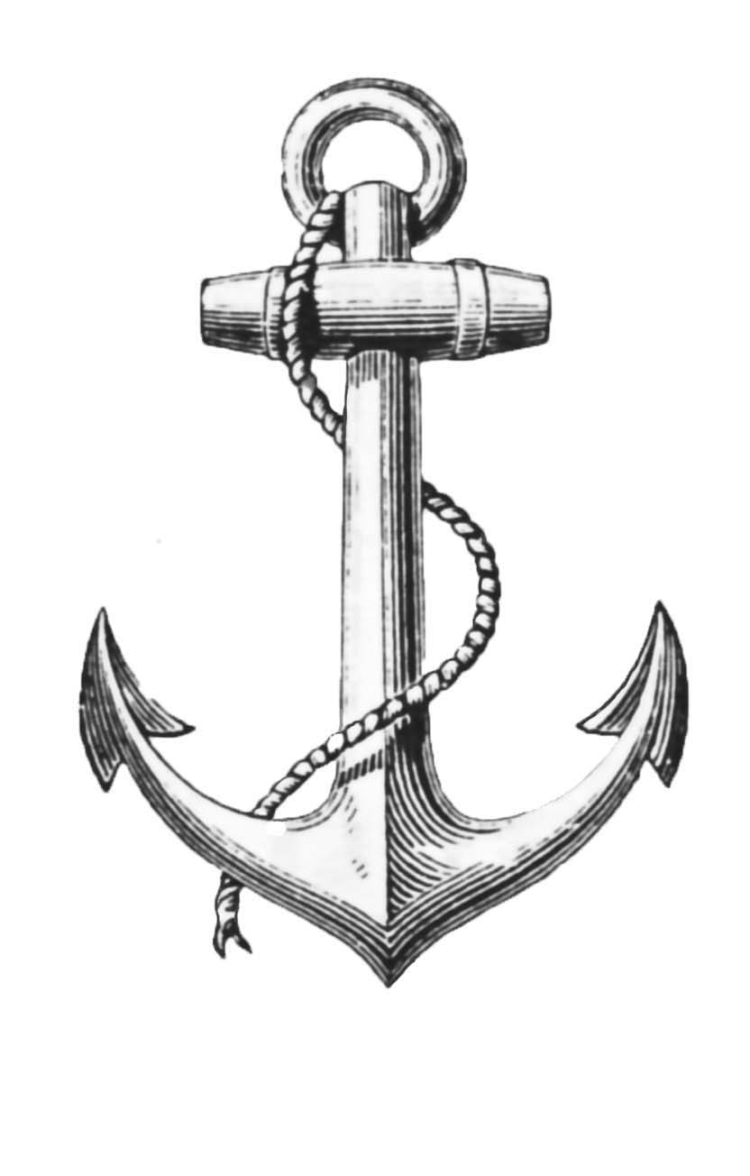
Are you feeling anchored?
Jane Hawthorne
jhawthorne@atsu.edu
480-219-6087
Katherine Adler
kadler@atsu.edu
660-626-2709

