Slide 1
Core Professional Attributes in Health Professions Education: Developing Institutional-level Assessment

Slide 2
Who We Are
Melanie Davis
Interim Director, Office of Assessment & Accreditation
Jane Hawthorne
University Data Manager

Slide 3
A.T. Still University
Founded in 1892 by Andrew Taylor Still, MD, recognized as the father of osteopathic medicine
Originally called American School of Osteopathy (one School only)
Now six schools in two states (one virtual)
Arizona School of Dentistry & Oral Health (ASDOH)
Arizona School of Health Sciences (ASHS)
College of Graduate Health Studies (CGHS-virtual)
Kirksville College of Osteopathic Medicine (KCOM)
Missouri School of Dentistry & Oral Health (MSDOH)
School of Osteopathic Medicine in Arizona (SOMA)

Slide 4
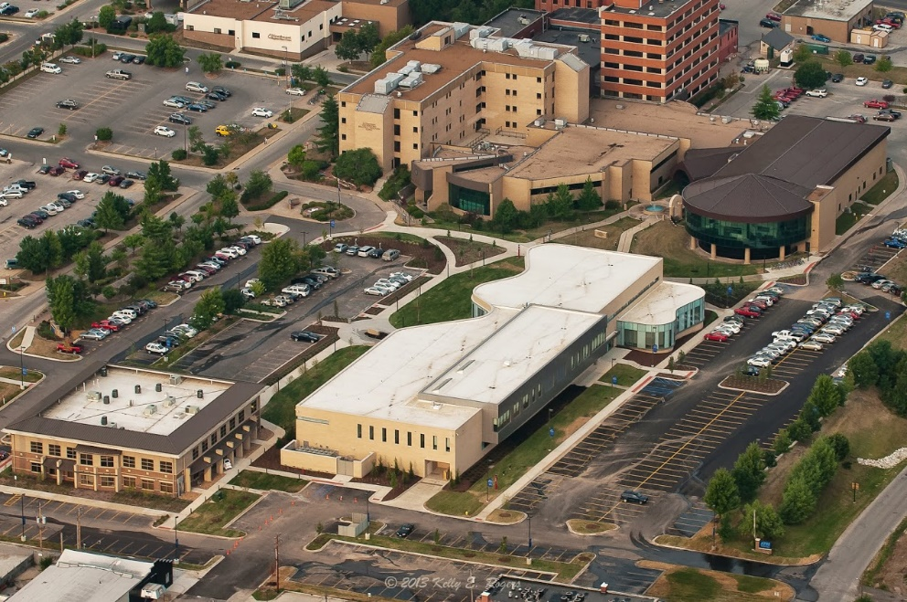
A.T. Still University
Notes:
Traditional, urban, rural, virtual…how do you bring these together?

Slide 5
Institutional Outcomes
ATSU joined HLC Assessment Academy May 2014 with University-level outcomes as our QI Project
Reinvigorated University discussions on institutional outcomes we call Core Professional Attributes
Notes:
“Transferable” was not clear to external audience and implied measurement occurred after graduation
Not all eight items were measurable
Eight items created a heavy burden on faculty and programs for documenting assessment

Slide 6
Quality Initiative Team
Ann Boyle, Associate VP – Academic Affairs
Randy Danielsen, Dean, Arizona School of Health Sciences
Melanie Davis, Interim Director, Office of Assessment & Accreditation
Norine Eitel, Assistant to the President, ALO
Jane Hawthorne, University Data Manager
Jim Lynskey, Associate Professor, Physical Therapy
Neil Sargentini, Professor & Chair, Microbiology & Immunology
Notes:
Range of people from faculty to staff to administrators

Slide 7
Tell Us Who You Are!
Institution type
Your role
Why are you here?
Do you have institutional outcomes?
Notes:
Raise your hands!
2 yr, 4 yr, graduate
Faculty, Administrator, Assessment Staff, ALO, Accreditation Staff/committee, IR/IE
What is motive—improve student outcomes, satisfy HLC, or a little of both
Y/N

Slide 8
Institutional Outcomes
Open Pathways Quality Initiative Project
Three year project; completing year 2
Revisited ‘stalled’ project

Slide 9
CORE PROFESSIONAL ATTRIBUTES
A set of cross-curricular meta skills inherent to ATSU graduates which enable them to select, adjust and apply their discipline specific knowledge and skills to different situations & enhance their competence as healthcare professionals.
Critical Thinking
Cultural Proficiency
Interpersonal Skills
Interprofessional Collaboration
Social Responsibility

Slide 10
Narrowing the focus?
Defining the CPA
Many elements and measurements
Finding 3 ‘Key Elements’

Slide 11
Programs
Notes:
How many ways can we say Goals? Nomenclature varies across the disciplines, sometimes by programmatic accreditation
We created a crosswalk but are using Program Goals, Course Outcomes, and Student Learning Objectives at the University level

Slide 12
By the Numbers: Mapping Program Outcomes to Core Professional Attributes (CPAs)
Italicized program name is residential offering | Number of Program Outcomes Mapped to CPAs
CPA | CT | CP | IS | IPC | SR
Dental Medicine - AZ | 6 | 3 | 4 | 4 | 8
Athletic Training | 5 | 3 | 3 | 4 | 1
Audiology | 1 | 1 | 1 | 1 | 2
Occupational Therapy | 12 | 4 | 6 | 5 | 8
Physician Assistant | 1 | 2 | 2 | 1 | 1
Physical Therapy | 3 | 1 | 2 | 1 | 2
Doctorate in Athletic Training | 4 | 2 | 3 | 3 | 1
Audiology | 1 | 1 | 1 | 1 | 2
Doctor of Occupational Therapy (OTD) | 5 | 2 | 3 | 1 | 6
Physician Assistant Studies | 2 | 2 | 2 | 1 | 2
Doctor of Physical Therapy | 1 | 1 | 1 | 1 | 1
Notes:
How we are tracking: Tk20
University assessment software

Slide 13
By the Numbers: Mapping Program Outcomes to Core Professional Attributes (CPAs) continued
Italicized program name is residential offering | Number of Program Outcomes Mapped to CPAs
CPA | CT | CP | IS | IPC | SR
Doctor of Health Administration | 4 | 10 | 3 | 3 | 3
Doctor of Health Education | 3 | 5 | 5 | 1 | 4
Doctor of Health Sciences | 2 | 1 | 2 | 2 | 2
Master of Health Admin | 4 | 11 | 3 | 3 | 3
Master of Science Health Ed | 3 | 5 | 5 | 1 | 4
Master of Science in Kinesiology | 2 | 2 | 2 | 1 | 1
Master of Public Health with Dental Emphasis | 12 | 1 | 3 | 1 | 9
Master of Public Health | 10 | 1 | 3 | 1 | 3
Doctor of Osteopathic Medicine- MO | 16 | 16 | 16 | 11 | 8
Master of Biomedical Sciences | 7 | 0 | 1 | 0 | 1
Dental Medicine - MO | 8 | 4 | 4 | 3 | 3
Doctor of Osteopathic Medicine- AZ | 11 | 4 | 8 | 5 | 6
TOTALS | 123 | 82 | 83 | 55 | 81
Notes:
How we are tracking: Tk20
University assessment software

Slide 14
Courses
Notes:
How many ways can we say Goals? Nomenclature varies across the disciplines, sometimes by programmatic accreditation
We created a crosswalk but are using Program Goals, Course Outcomes, and Student Learning Objectives at the University level

Slide 15
Mapping Course Outcomes to Core Professional Attributes:
An Example from SOMA
Notes:
Word of caution: Course outcome listed #3 is actually 2-3 separate outcomes.
Course Outcomes to CPAs
PERHAPS THE LAST OUTCOME IS MISSING THE CODE OF CONDUCT AND AN ‘X’ SHOULD BE INDICATED

Slide 16
Assessing Core Professional Attributes: Evidence of Learning
Quizzes/Tests/Labs: Written, Oral & Skills Performance
Capstone Projects, Portfolios
Research Publication Dissertation
Practicums, Field Experience
Licensure Exams Scores
Reflection Papers
Case Studies

Slide 17
Opportunities to Measure Impact on Learning
Pre-test at orientation
Identify instrumentation
End of didactic experience
Surveys to be developed
Post-test at graduation
Alumni surveys 3-5 years out
Notes:
Pre-test not yet done
Didactic end example: KCOM
Grad exit interviews and surveys already exist; another survey or added to current surveys?

Slide 18
What Are You Doing?

Slide 19
Q & A
If you have additional questions or feedback, please do contact us! We’d love to hear from you.
Melanie Davis: mdavis@atsu.edu
Jane Hawthorne: jhawthorne@atsu.edu

