Slide 1
A.T. Still Research Institute
Interdisciplinary Biomedical Research Symposium
Information for
IBRS Presenters

Slide 3
Jump to
2025 Timeline
Submission Timeline
Jump to poster formatting
Abstracts:
August 18: Abstract submissions & registration opens
October 15: Abstract submissions close (11:59 pm CDT)
October 29: Abstract re-submission deadline (11:59 pm CDT)
Digital posters and video presentations (for ALL in-person and online presenters) :
November 3: Digital posters & videos due by 4:00 pm (CDT) to ibrs@atsu.edu
ATSU poster printing deadline (in-person presenters only) :
November 3: Digital file of poster due by 4:00 pm (CDT) to jcarroll@atsu.edu
**researchers from institutions other than ATSU should utilize printing services available to them at their institution.
Oral Presentations:
November 7: Slide decks due by 4:00 pm (CST) to ibrs@atsu.edu
Printed posters:
November 14: Physical posters 1:00-5:00 pm (CST) to IPE Building for display
November 15: Physical posters 8:00-8:30 am (CST) to IPE Building for display
Judging:
November 10 - 14: Poster pre-judging in Gathertown
November 14: Pre-judging closes at 5:00pm (CST)
November 15: Interdisciplinary Biomedical Research Symposium (online & onsite)
Poster & Oral presentations & judging
Jump to video formatting

Slide 4
Jump to
2025 Timeline
2025 Categories
Jump to poster formatting
Anatomy
Behavioral Health
Biochemistry
Biomechanics
Cancer
Clinical Assessment and Diagnostics
Clinical Case Report
Educational Research
Exercise Science
Health Sciences
Infectious Disease
Microbiology
Musculoskeletal
Osteopathic Manipulative Medicine
Oral Health
Pharmacology
Physiology
Social Determinants of Health
Jump to video formatting

Slide 5
Jump to
2025 Timeline
2025 Classification
Defined by the main principal investigator or the majority of authors
Jump to poster formatting
Graduate level student:
Basic sciences research
Clinical research
Educational research
Resident or Post Doctoral Fellow
All areas of research
Faculty or Staff
All areas of research
High School
All areas of research
Undergraduate student
All areas of research
Jump to video formatting

Slide 6
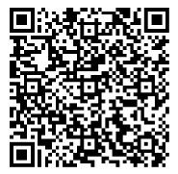
Jump to
2025 Timeline
Abstract Guidelines
Jump to poster formatting
Submission: August 18 - October 22, 2025
Register on Eventbrite
Abstract Submission: https://ibrs.virtconf.page/
Title: Limited to 75 characters including spaces
Abstract: Limited to 2500 characters including spaces
Format:
Original Research - four sections
Background, Methods, Results, and Conclusions
Case Study - six sections
Background, Patient, Intervention or Treatment, Outcomes or Other Comparisons, Conclusions, and Clinical Bottom Line
Literature Review - four sections
Introduction, Methods, Results, and Conclusion
The work described in the abstract may be a completed project or a work in progress.
**PLEASE NOTE: registration and abstract submission take place on two separate systems. ALL attendees must be registered to attend IBRS. Lunch will be included for all in-person attendees registered by no later than November 10th.
Jump to video formatting
Scan to register for IBRS

Slide 7
Jump to
2025 Timeline
Abstracts have four possible outcomes:
Jump to poster formatting
Accepted-Poster
Congratulations, your abstract has been accepted to the symposium as a poster.
All posters must send a copy of their poster to ibrs@atsu.edu for prejudging.
All posters must send a video to ibrs@atsu.edu for prejudging
Posters to be displayed onsite must arrange for physical printing.
Tentative-Oral
Congratulations, your abstract has advanced to the oral presentation committee for review.
Your abstract may be accepted as an oral presenter, or it may be accepted as a poster.
Accepted-Oral
Congratulations, your abstract has been accepted as an Oral presentation.
No posters or videos are required. Slide decks (Preferred format: Google Slides) should be submitted to ibrs@atsu.edu
Returned
Study the reviewer’s feedback and resubmit your abstract.
Jump to video formatting

Slide 8
Judging Rubric

Slide 9
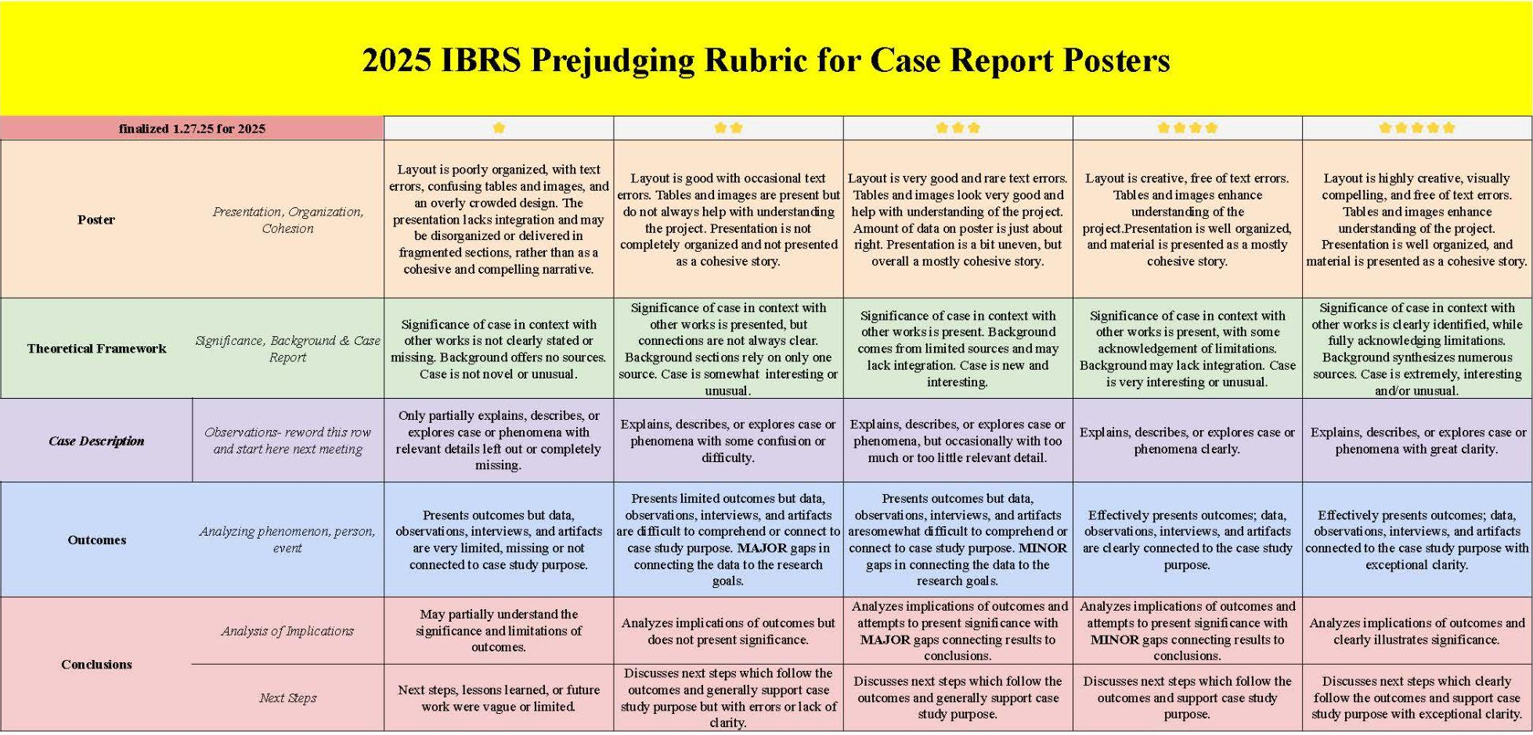
Judging Rubric

Slide 10
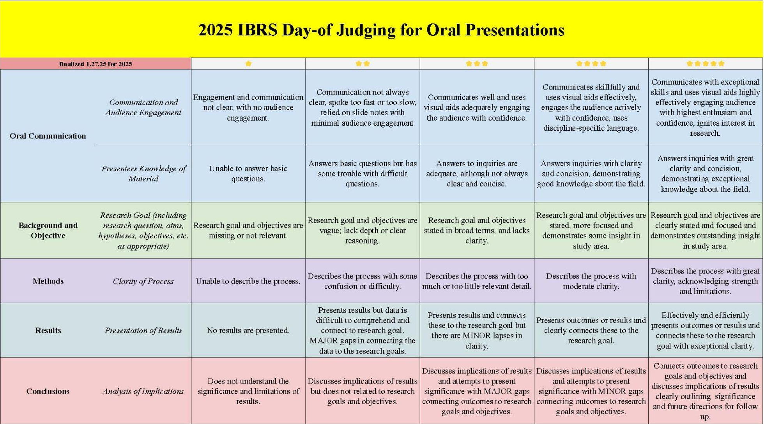
Judging Rubric

Slide 11
Judging Rubric

Slide 12
Jump to
2025 Timeline
Jump to
2025 Timeline
Posters
Pro Tip:
Check your document size BEFORE you begin your layout to avoid scaling issues.
Jump to poster formatting
Poster Size
Limited to 56”(w) x 40”(h)
Heading - include title and author(s) in font at least 1” high
Body - font should be heavy and at least ⅜” high
ATSU Template (optional) ATSU/NRMC Template (optional)
Electronic File - each presenter team must submit one copy for pre-judging in Gathertown
Portable Network Graphics (PNG) format ONLY - less than 3MB in size
Must be PNG format so your poster will be viewable.
Submit to ibrs@atsu.edu
Poster Printing - in-person presenters only
PDF format ONLY
Presenters are responsible for:
Poster printing
Delivery of physical poster to the IPE building
Jump to video formatting
Pro Tip:
Use PowerPoint or
Google Slides to create
your poster at full size
Pro Tip:
Save your poster as both a
PNG and a PDF for submission!

Slide 13
Jump to
2025 Timeline
Jump to
2025 Timeline
Physical Posters (on site)
Jump to poster formatting
Researchers at ATSU (MO)
Researchers must submit posters for printing
No charge for poster printing for ATSU employees and ATSU students working with faculty. However :
If there is a reprint needed due to a typo or other error on the researcher's part, we do charge a $50 reprint fee to help cover part of the paper and ink costs.
A $50 rush fee will be charged for posters submitted with less than two days lead time to print.
Email “print-ready” poster files in PPT or PDF format (Apple users submit PDF only) to Jamie Carroll jcarroll@atsu.edu .
If researchers need graphics created for their poster, contact Jamie Carroll jcarroll@atsu.edu.
Researchers at other institutions
Utilize your institution’s printing services. Contact them for formats and deadlines.
Jump to video formatting

Slide 14
Videos
Jump to
2025 Timeline
All accepted abstracts are required to provide a video of their poster presentation for prejudging.
This recording is of your poster presentation for judges and attendees.
Videos should be 1 minute in length. (NOT longer than 2 minutes.)
Video format should be MPEG-4 (might be called MPG4, depending on the recording software).
Imagine this video as a TikTok or Google Shorts clip that gives the audience a quick summary of your poster.
Recording can be done with Zoom, Google Meet, OBS Studio, YouTube, or on your mobile device.
Do not host your video - video files must be emailed (or shared) to ibrs@atsu.edu so they can be attached to your poster in GatherTown.
General tips
Use excellent lighting and the best audio available.
Limit busy backgrounds unless that's part of the story.
Reference your poster, do not share it on screen. (Your digital poster will be available for viewers.)
Jump to poster formatting
Jump to video formatting

Slide 15
Jump to
2025 Timeline
Jump to
2025 Timeline
Symposium Day
Jump to poster formatting
Onsite Location:
A.T. Still University – Kirksville, Missouri, campus
Interprofessional Education (IPE) Building – Second floor
500 W. Jefferson St.
Kirksville, MO 63501
Online Location:
Gathertown (link will be provided via email)
Presenters living more than 100 miles from Kirksville may choose to exhibit virtually on Gathertown. All others will present in person.
Presenters will need to be present at their posters for one hour during their assigned session and during the General Poster Session.
Jump to video formatting

Slide 16
IBRS Event Schedule
Jump to
2025 Timeline
Jump to
2025 Timeline
Time (CST) | Event | Kirksville Location | GatherTown Location
8:00 am - 8:30 am | Poster hanging | IPE Building, Rooms 151/153
8:30 am - 8:55 am | DOORS OPEN/General Admission Check in | IPE Building, Lobby | Plenary Hall
9:00 am - 9:15 am | Welcome and Opening Remarks | IPE Building, Room 241 | Plenary Hall
9:15 am - 10:15 am | Oral Presentations (Session 1) | IPE Building, Room 241 | Plenary Hall
10:15 am - 10:30 am | Break
10:30 am - 11:30 am | Poster Presentations (Session A) | IPE Building, Rooms 151/153 | Poster rooms (401-436)
11:30 am - 12:30 pm | Lunch (must be registered) | IPE Building, Rooms 257/259
12:30 pm - 1:15 pm | Keynote Speaker | IPE Building, 2nd floor Classroom | Plenary Hall
1:15 pm - 2:15 pm | Oral Presentations (Session 2) | IPE Building, 2nd floor Classroom | Plenary Hall
2:15 pm - 2:30 pm | Break
2:30 pm - 3:30 pm | Poster Presentations (Session B) | IPE Building, Rooms 151/153 | Poster rooms (401-436)
3:30 pm - 4:15 pm | General Poster Session (All Posters) | IPE Building, Rooms 151/153 | Poster rooms (401-436)
4:15 pm - 4:30 pm | Awards and Closing Remarks | IPE Building, 2nd floor Classroom | Plenary Hall
4:30 pm - 5:00 pm | Remove physical posters | IPE Building, Rooms 151/153
Jump to poster formatting
Jump to video formatting

Slide 17
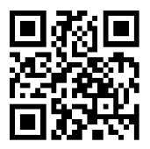
Jump to
2025 Timeline
Jump to
2025 Timeline
Jump to poster formatting
Website:
atsu.edu/ibrs
Jump to video formatting
Questions? Comments? Concerns?
Email: ibrs@atsu.edu

