Slide 1
Increasing Physical Therapy Students understanding of and skills for working with community dwelling older adults using the Matter of Balance: Managing Concerns About Falls
Lori M. Bordenave, PT, DPT, MEd
Elton L. Bordenave, MEd, CHC
Cecelia Sartor Glittenberg, PT, PhD, NCS
Jeff Alexander, PhD, FAACVPR
WWW.ATSU.edu

Slide 2
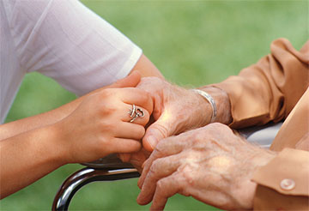
A.T. Still University Geriatrics Initiative
Established by the university board of directors in 2004
Focused on both in class “didactic” education and community based “service learning”
Specifically called for establishing collaborations with external entities
Model programs that improve the quality of life for seniors
Initiative Mission Statement
“Develop a new generation of health professionals with a passion for improving the quality of life for seniors.”

Slide 3
Developing the Outreach:
2004-2008
What could students do (that they would care about)?
Supervision?
What could we do that would be useful and effective?
Where would we find a population to help?
What about the lawyers?
Scope of Practice
Definition:
The range of responsibility–e.g, types of patients or caseload and practice guidelines that determine the boundaries within which a physician, or other professional, practices.

Slide 4
Falls & Older Adults
Falls represent a problem with a multi-disciplinary solution
Falls are epidemic and support for prevention efforts is widespread
Falls in Arizona
In 2006, Arizona ranked 5th in the nation for unintentional fall-related deaths among adults age 65 years and older.¹
Between 2000 and 2008, there was a 91 percent increase in the rate of deaths over nine years.

Slide 5
The Matter of Balance: Managing Concerns About Falls
Research by the Roybal Center for Enhancement of Late-Life Function at Boston University.*
Designed to reduce the fear of falling and increase the activity levels of older adults who have concerns about falls.
* Tennsdedt, S., Howland, J., Lachman, M., Peterson, E., Kasten, L. & Jette, A. (1998). A randomized, controlled trail of a group intervention to reduce fear of falling and associated activity restriction in older adults. Journal of Gerontology, Psychological Sciences, 54B (6), P384-P392.

Slide 6
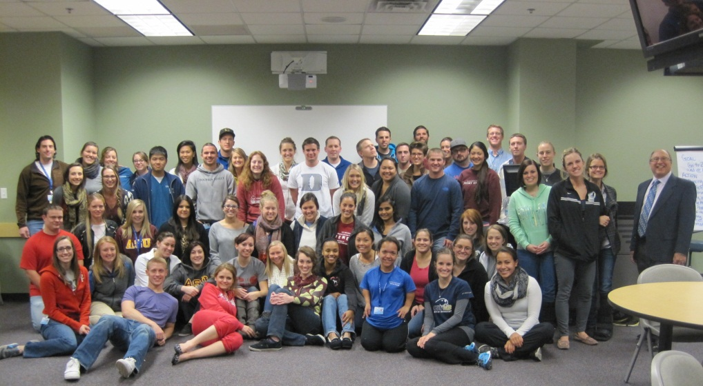
The Matter of Balance: Managing Concerns About Falls
Master Trainers
Faculty and community partners
Volunteer Lay Leaders
Students as coaches
8 week class
Off campus in community settings

Slide 7
Identifying the Right Community Partners
Partners
Access to the population
Flexibility in scheduling programming
Committed to health education programming
Willing to embrace evidence based methods.
Committed & enthusiastic site management

Slide 8
Outcomes

Slide 9
What do the students get?
Experience teaching an evidence-based program
Interaction with older adults
Enhanced understanding and awareness of aging issues
Experience working in an interdisciplinary team
Unexpected discoveries

Slide 10
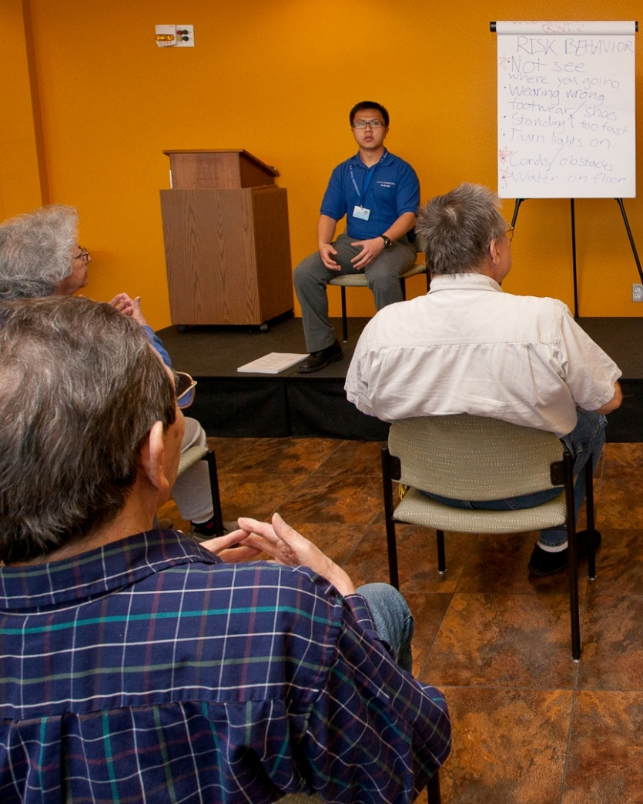
What do the students say?
“Prior to even meeting any of the participants, I think I had envisioned that they would all be quite old, frail, and have had fallen before, but on the first day my assumptions were proven incorrect.“

Slide 11
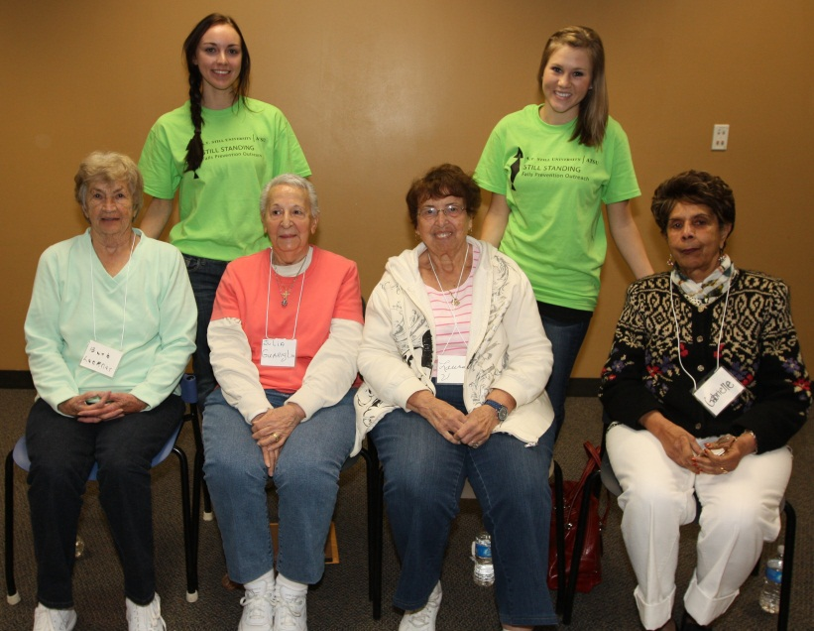
What do the students say?
“Every single participant was excited to be there and eager to learn new exercises. I was surprised how pleased they were about working with “young kids”. The population I worked with was bright, energetic, and social. Most of the participants were extremely mobile as well. This surprised me because I expected them to be less so; I pictured more dependent individuals who relied on assistive devices to ambulate.”

Slide 12
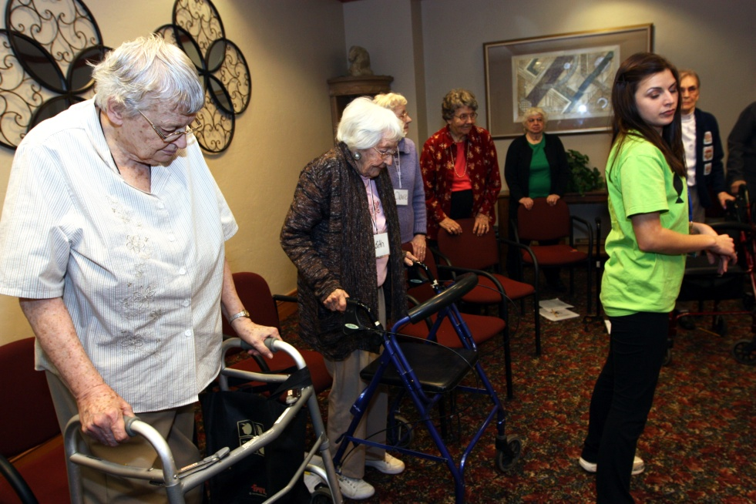
What do the students say?
“Each participant had something to offer and share with the group and really helped broaden my knowledge and insight as to what they go through on a daily basis.”

Slide 13
What do the students say?
“I learned how to feel confident in front of a class, how to adapt my teaching style, and about the senior population. “
“This project has influenced my potential to participate in future volunteer programs as a leader in my community. This was my first teaching role I have participated in besides teaching kids and it has given me the enthusiasm to continue to be a leader. I now have the confidence to teach other courses, which in the long run will carry over to educating others in the clinical setting.”

Slide 14
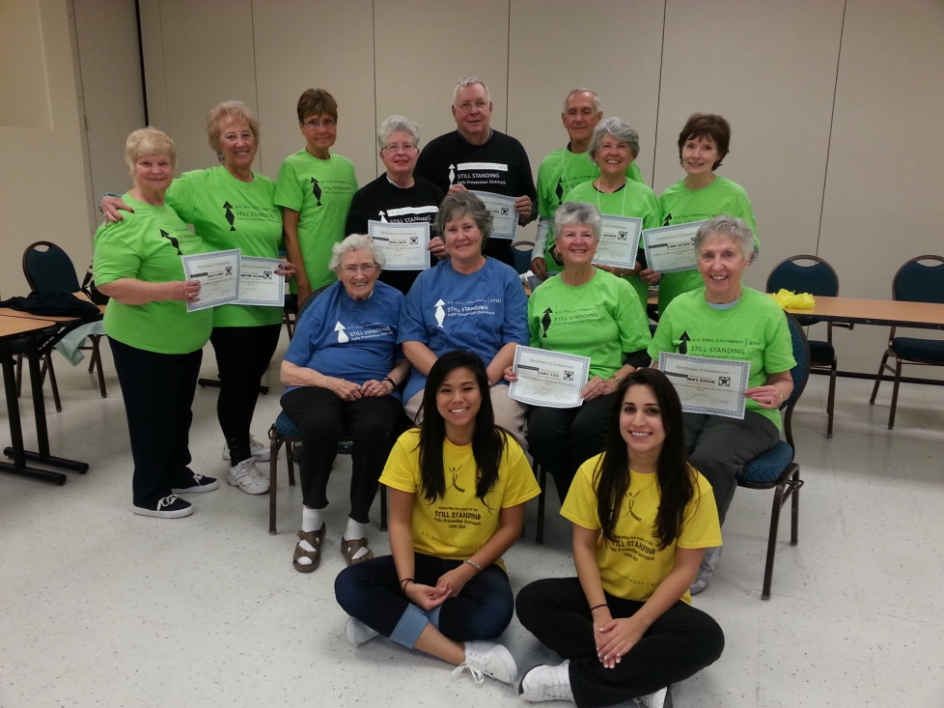
What we learned along the way
It Takes Time
Be up front and be flexible
Simple, consistent communication is key
Make it easy
Faculty participation is essential

Slide 15
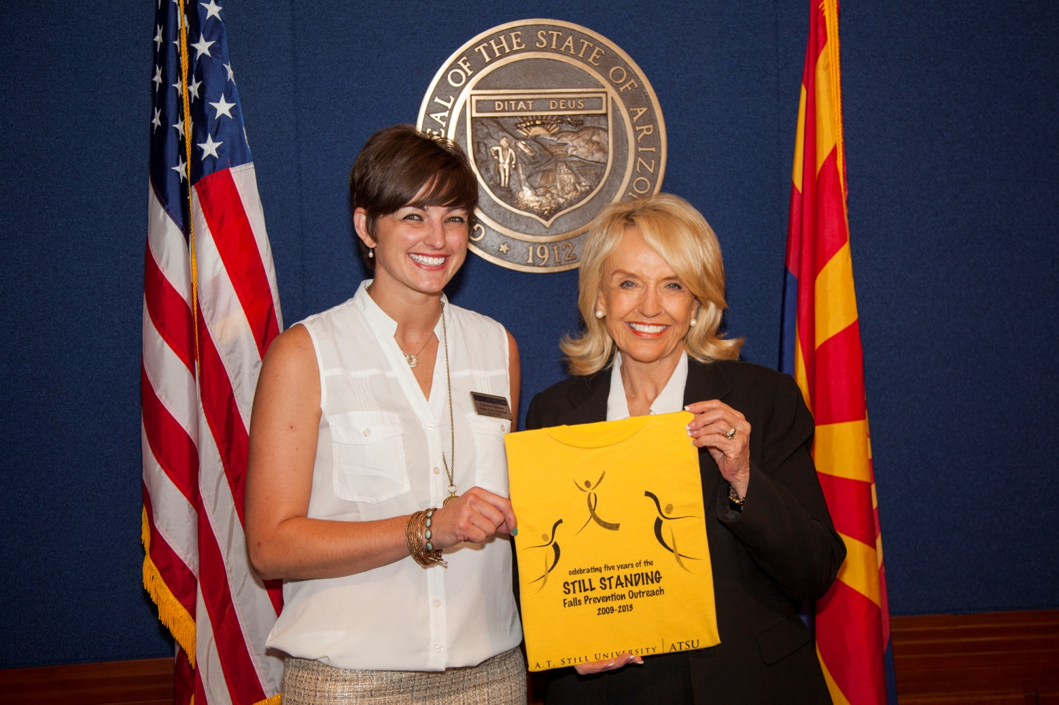
Thank You!
lbordenave@atsu.edu

